Slide 1
Uber for bikes
Web and Cloud Computing
Group 18
Thom Carretero Seinhorst
Anastasia Serebryannikova
Alexandru Tatarov

Slide 2
Project description
The application will represent a map on which positions of some bikes will be shown. These bikes are used by people for transportation. When a bike is taken, it’s corresponding point on the map disappears (because it is no longer available). When the trip is finished the bike appears back on the map. For every bike, there will be a usage history available.

Slide 3
Used technologies
Front-end: HTML, CSS, JavaScript, Google Maps API, AJAX
Back-end: Java, RabbitMQ/Kafka
Databases: Cassandra/MongoDB

Slide 4
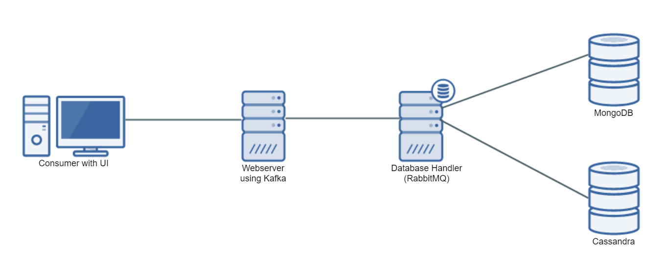
Overview

